Slide 1
Introduction to the Scheduler

Slide 2


Welcome!
Notes:
ON SCREEN
Welcome back! In this video, we will talk about the OS Scheduler, process states, and signals. Let’s get started!
[CLICK – Next Slide]

Slide 3




The Scheduler
The scheduler is a part of the OS that handles process scheduling.
Complex, different algorithms, etc...
The scheduler decides which process gets to run (and when).
Not necessarily first in first out – from the process table
The scheduler is ready to respond after interrupts (I/O, etc.).
It has to know where to stop, where to restart.
Balances needs of processes to avoid problems (i.e., starvation).
Notes:
OFF SCREEN
So, what is the scheduler? [CLICK]
I have mentioned that the OS implements pseudoparalellism, in which each process runs for a small fraction of time, or a quantum of time, and is replaced by a new process to be executed.
The scheduler is the part of the OS that handles process scheduling. It is a complex piece of the OS and involves several different algorithms. [CLICK]
As I mentioned, one of the Scheduler’s job is to choose which process to run in the next quantum of time. [CLICK]
The Scheduler must also be ready to respond after interrupts occur.
An interrupt causes a running process to be preempted (removed from the CPU). Once the interrupted has been treated, the scheduler must choose another process to run. [CLICK]
The Scheduler also balances the needs of all processes. It must make sure, for example, that all processes get a turn to be executed, and no process is left behind.
If a scheduling algorithm allows a process to “never” run, we say that that process is “starving”, or that there is “starvation”.
[CLICK – Next Slide]

Slide 4
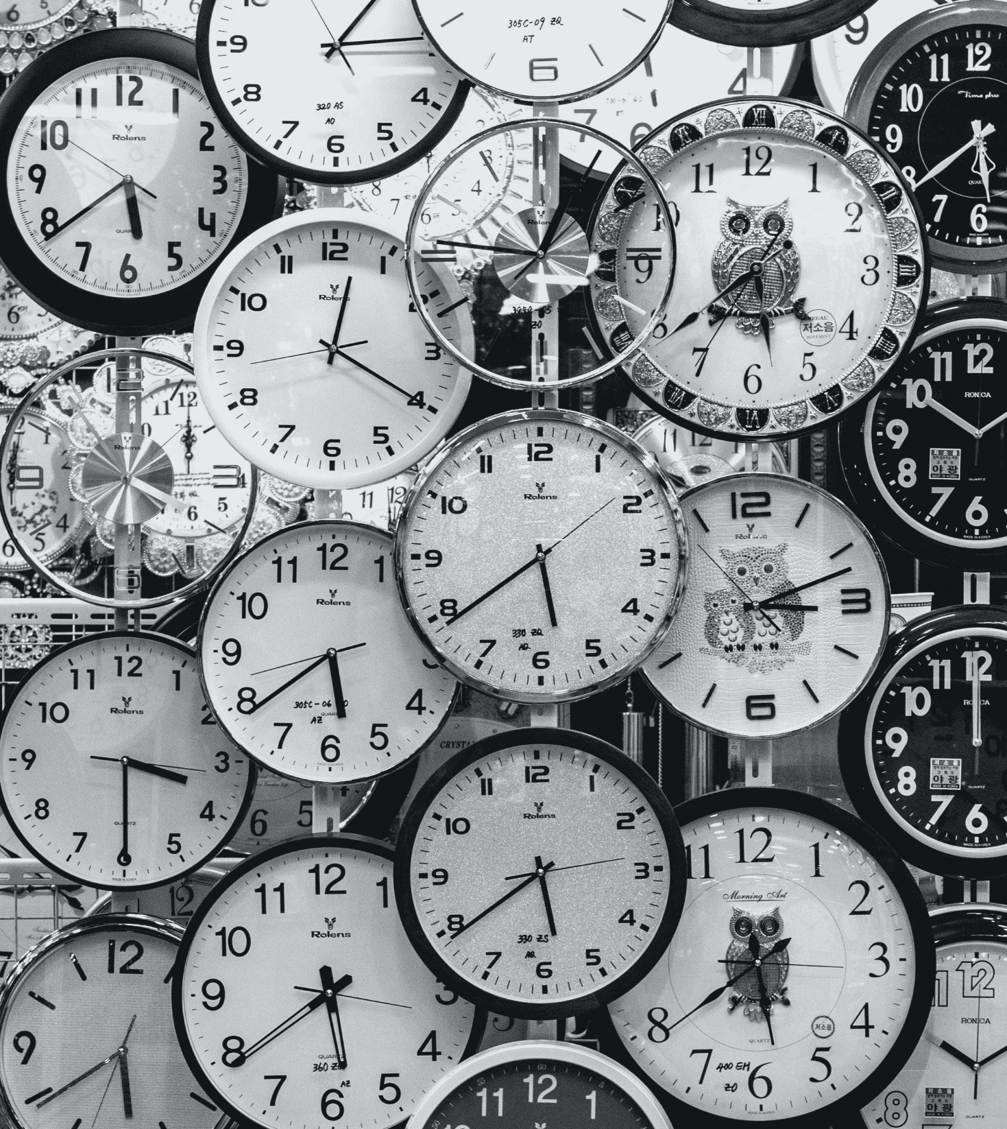
Who Schedules the Scheduler?
1
The OS enters kernel mode.
2
The old process is removed and stored in memory.
3
A new process is loaded.
4
The OS switches back to User mode, and the process runs.
5
The scheduler sets an alarm.
When the alarm goes off, the OS interrupts the running process, and the scheduler is executed.
6
7
The cycle repeats itself.
Notes:
OFF SCREEN
Now, an interesting question: Who Schedules the scheduler? [CLICK]
To run the scheduler, the OS enters kernel mode. [CLICK]
When the scheduler runs, the old process is removed from the CPU, and stored in memory. [CLICK]
Then, a new process is loaded into the CPU registers. [CLICK]
Once the new process is loaded, the OS switches back to User mode, and the process runs.
However, something else happens. [CLICK]
Before allowing the new process to run, the scheduler sets an alarm using one of the several timers managed by the OS. That alarm is set to go off once precisely a Quantum of time has passed. [CLICK]
When the new process is running and the alarm goes off, the OS interrupts the running process, and the Scheduler is executed. [CLICK]
The cycle, then, repeats itself, and a new process is selected by the scheduler.
And this is how the scheduler is scheduled!
[CLICK – Next Slide]

Slide 5
Process States
There are several possible states.
1
2
3
Running Executing instructions
Ready Runnable – not currently executing instructions
Blocked Waiting on an external event Has yielded the CPU
Swapped Out & Blocked Not in RAM Waiting on an external event
Swapped Out & Ready Not in RAM Ready to execute upon load
Initializing Preparing process to run
Exiting Shutting down – cleaning up following execution
Notes:
OFF SCREEN
Before we continue analyzing the scheduler, let’s look at process states. The scheduler will schedule only processes that are ready to run. So, states are important!
Processes can assume several states: [CLICK]
Running: loaded into the CPU, executing instructions;
Ready: they are runnable – loaded in main memory, but not currently executing in the CPU. The scheduler picks one of the Ready processes to run next.
Blocked: A blocked process is not scheduled to run. The process may be waiting on an external event – an I/O operating to finish, for example. [CLICK]
Processes can also be Swapped Out & Blocked and Swapped Out & Ready.
“Swapped out” means that they are not in main memory. They have been saved in fixed storage, such as the hard drive.
They enter this “Swapped out” states when there isn’t enough main memory to store all the processes needed. [CLICK]
Processes can also assume the Initializing state, a state in which they are preparing to run, and an Exiting state, when they are shutting down and cleaning up after execution.
[CLICK – Next Slide]

Slide 6
Process State Diagram
Initializing
Exiting
Initialized
Ready
Select & Dispatch
Running
Halt
Swap In
Preempt
Unblock
Swap Out
Block
Swapped-Out and Ready
Blocked
Swap In
Unblock
Swapped-Out and Blocked
Swap Out
Swapped: Swapped from main memory to storage
!
Notes:
OFF SCREEN
The picture shows a representation of the possible states of a process.
Note that a process can go from Initializing to Ready.
A ready process that is scheduled to run by the scheduler changes its state to Running.
A Running process can go back to being ready (for example if it ran for a quantum of time, but still needs to run more…); a process can exit (if it has finished its tasks), or can enter a blocked state (for example by requesting an I/O operation).
A ready or blocked process can be moved to storage, and enter a “Swapped-out and Ready” or “Swapped-out and Blocked state”.
In these states, they cannot be executed. They must first be loaded back into memory, to Ready or Blocked states.
[CLICK – Next Slide]

Slide 7
Context Switching
The scheduler switches between two processes.
Context switches occur because of:
Blocking Operations
I/O (Voluntary)
CPU Yield Operations
Sleep. I don't want run now. (Voluntary)
CPU Sharing
Time has expired, or more important process to run. (Involuntary)
Asynchronous Events (Involuntary)
Hardware Interrupts
Signals (Software Interrupts)
Exceptions (Divide by zero, etc.)
In this case, the OS must:
Store register values
Track memory addresses
Update process state
Notes:
OFF SCREEN
Every time the scheduler switches between two processes, we say that there is a “context switch.”
This means that the context of the CPU (in other words, the content of its registers) are replaced with new information, and a new process can be executed.
Although very small, context switches take time. Some cycles of the CPU are spent managing context switches, instead of executing the “real” work of processes. [CLICK]
Context switches can occur for several reasons: [CLICK]
When a process asks for an I/O operation it is blocked until that operation is carried out by the OS. When it blocks, a new process must run in its place, and a context switch happens. [CLICK]
A process may reach a point where it doesn’t want to run. Think about a wait or sleep operation. In the middle of its allocated quantum, it may reach a wait or sleep instruction. The process, in this case is telling the OS that it does not want to run anymore, at least for some time. It is yielding the CPU. A new process must run in its place, and a context switch happens. [CLICK]
Context switches also occur due to pseudoparallelism.
Pseudoparallelism requires multiple processes to share the CPU. Each process can run at most for a quantum of time each turn. Once the quantum of execution of a process has passed, the scheduler must be called to select which process to run next, and a context switch happens. [CLICK]
Asynchronous events may also cause context switches, such as hardware interrupts, Signals, and Exceptions. [CLICK]
When a context switch happens, the scheduler must: Store register values in main memory, keep track of allocated memory addresses, and update the process state in the PCB.
[CLICK – Next Slide]

Slide 8



Handling Signals
Kernel receives signal via system call (preparation): (e.g., Process1 signals Process2 by making a system call)
System call “flags” that process in the PCB, indicating there is a signal pending.
When the time comes for the process to run, instead of running, the signal is dealt with...
If PCB has registered handler for the target, the signal is stored, and handler queued to execute.
If there is no registered handler, the target process is terminated.
Once handler / termination completes, normal function continues.
If a process receives a signal and a handler is registered to catch the signal, the handler is executed. Otherwise, the process is terminated!
!
Notes:
OFF SCREEN
We mentioned the Signals can cause context switches. So, let’s look closer at Signals. [CLICK]
Signals are generated by system calls and are used so that messages can be passed to a process.
The Kernel or other processes can issue signals. For example, Process1 signals Process2 to it must terminate. [CLICK]
The system call “flags” the receiving process in the PCB, indicating that it has received a signal. [CLICK]
When the process is scheduled to execute, before running, the signal is treated. [CLICK]
If the process has registered a handler to treat the signal in the PCB, the signal is stored and a handler is queued to execute. [CLICK]
If there is no registered handler in the PCB, the target process is terminated. [CLICK]
Once a handler is executed or termination completes: normal execution of the process continues, or a new process is scheduled. Important to note, however, that not all signals can be treated. [CLICK]
Put simply, if a process receives a signal and a handler is registered to catch and treat the signal, the handler is executed. Otherwise, the process is Terminated!!
[CLICK – Next Slide]

Slide 9
Signals
Signal | Description | From
SIGILL | Illegal Instruction | Kernel
SIGSEGV | Segmentation fault | Kernel
SIGKSTOP | Shutting down | Kernel
SIGPIPE | Pipe fault | Filesystem
SIGTERM | “Polite” kill | KILL syscall
SIGKILL | Kill (no catching) | KILL syscall
SIGALARM | Alarm expired | Varies
Notes:
OFF SCREEN
Here are some examples of signals:
If a process tries to allocate a memory area that is not allowed by the OS, [CLICK]
the Kernel may issue a Segmentation Fault. The process may catch the signal, or it will be terminated. [CLICK]
Some signals cannot be treated. [CLICK]
The Sigkill signal is one example.
This means that, if a process receives this signal, it will be terminated.
[CLICK – Next Slide]

Slide 10
Thank You

